Slide 2
Bridging the Gap: 2011/2012 The Jewish-Arab Art Program at the Youth Wing for Art Education
Bridging the Gap is made possible through the generosity of the German Friends of the Israel Museum

Slide 3
The joint Arab-Jewish art class for Jerusalem schoolchildren has been running for the last 19 years and since 2010, the German Friends of the Israel Museum have been active and generous supporters.

Slide 4
Every year Bridging the Gap rises to the increasingly difficult challenge of strengthening ties between the Arab and Jewish communities co-existening in Jerusalem.

Slide 5
The 2011/12 program began on October 2011 and comprises two classes: one made up of sixth grade students and the other of eighth grade students. Total participation: 76

Slide 6
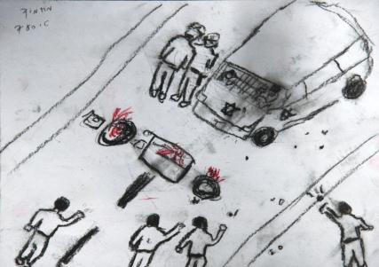
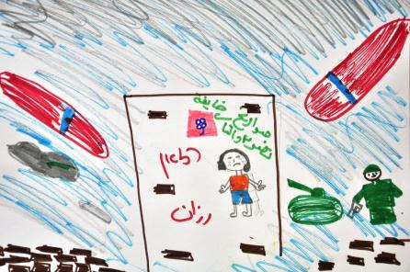
2011/2012 – The Mission: Addressing Difficult Issues
"We chose to put forth the obstacles – let the students face them – because THIS is reality." (Eldad Sha'altiel, program director)

Slide 7
The first lesson for both the 6th and 8th graders was a joint meeting for students and parents.

Slide 8
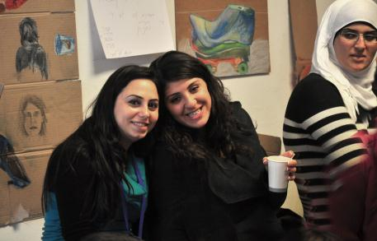
The 6th grade students were taught by Hannan Abu-Hussein, Orly Nir, Rowan Abu-el-Hawa and Ayala Landau
The 9th grade students were taught by Hannan Abu-Hussein and Anat Barel, and Hanin Magadla and Ohad Hoffman were group instructors.

Slide 9
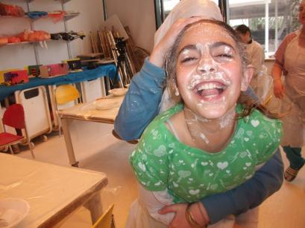
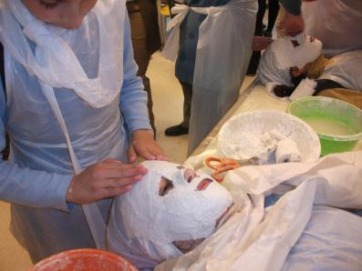
Inspired by masks that are exhibited in the Israel Museum galleries, the students cast masks of each other, which fostered dialogue and intimacy between them.

Slide 10
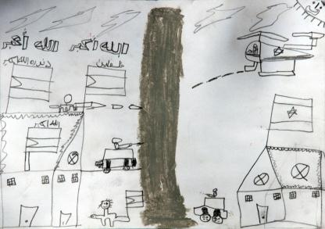
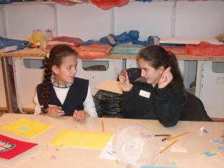
Bridging the Gap has proven to be a twofold success: Firstly, the Jewish and Arab students both chose this art program as their preferred after school activity, and demonstrated their commitment to it throughout the year.
Secondly, the program successfully addressed the hard-core issues that intrigue students on both sides, without ‘sugar-coating’ them.

Slide 11
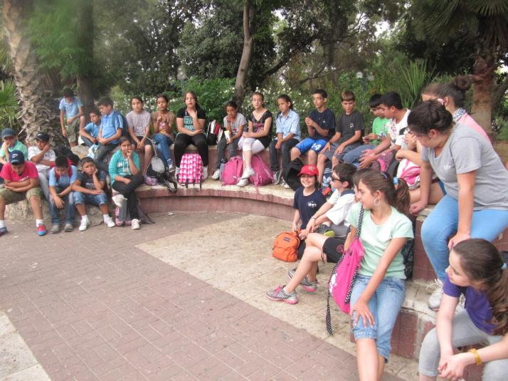
In June 2012, all 6th grade students went on a trip to Jaffa.

Slide 12
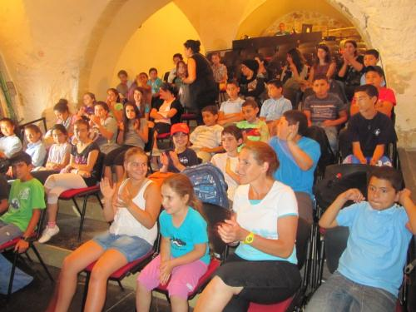
The children watched a play called “The Trip to the Cheese Planet” by the Arab-Hebrew Theater, Jaffa.
The play revolves around two good friends, an Arab and a Jew, who fly together in a spaceship to another planet.

Slide 13
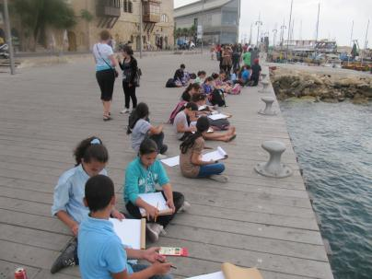
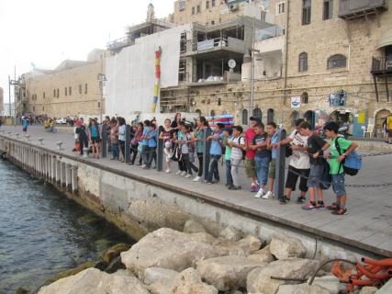
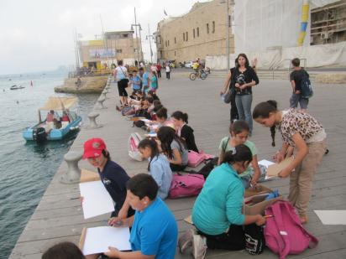
The play was followed by a walk around Jaffa port and a painting session at sunset

Slide 14
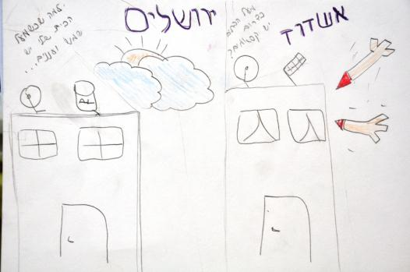
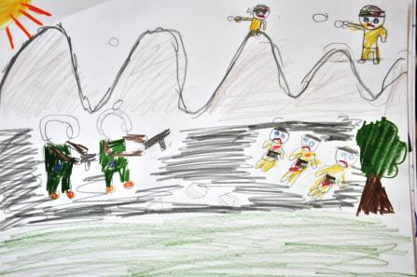
Real co-existence: Letting the children hear the two sides of the story.
Students’ mages from the session following IDF retaliation in Gaza, for missile attacks on southern Israel.
“How come when the sun shines over my house in Jerusalem, missiles fly over the houses in the south?”
“Israeli soldiers kill Palestinian children!”

Slide 15
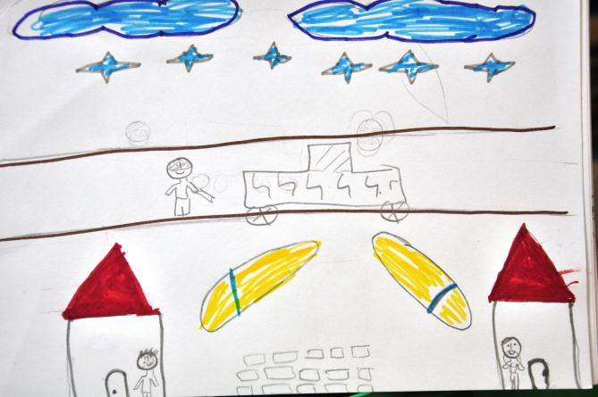
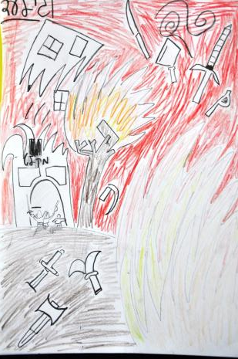
This year, based on the evaluation recommendations of last year, senior classes were accompanied by a teacher-artist and a group consultant.
There were fundamental differences in the students’ approach to the notions of 'identity' and 'nationality'.

Slide 16
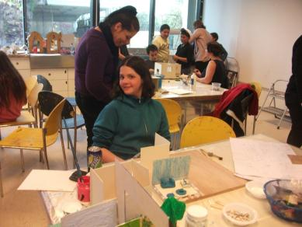
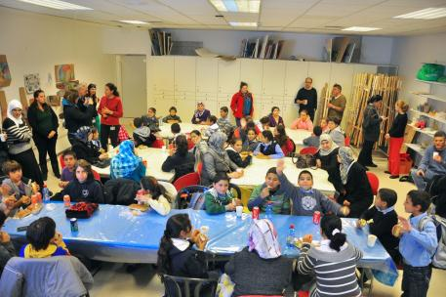
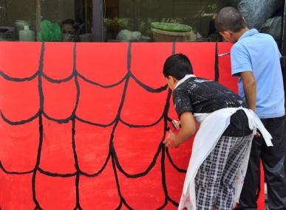
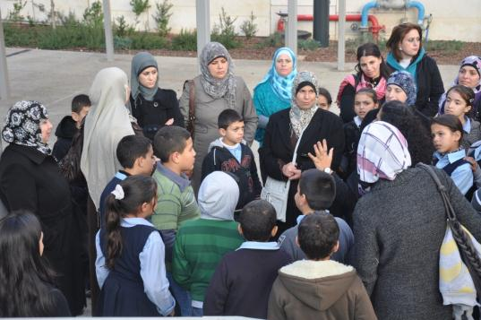

Slide 17
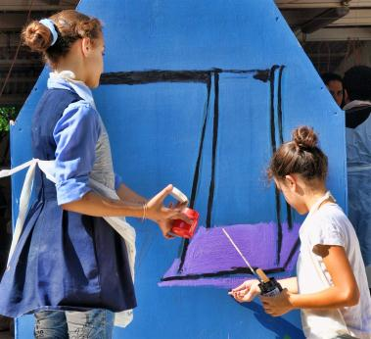
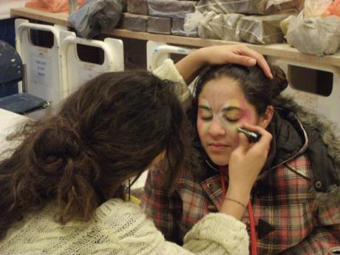
"Our role here is not to bring peace to the Middle East" said Eldad Sha’altiel.
"We settle for telling the two stories of the two peoples here, and let each side get a glimpse into the other side."

Slide 18
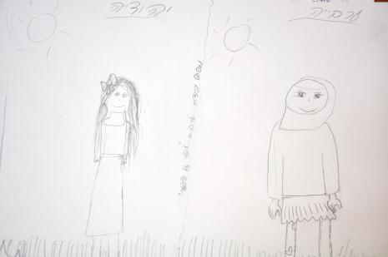
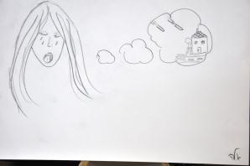
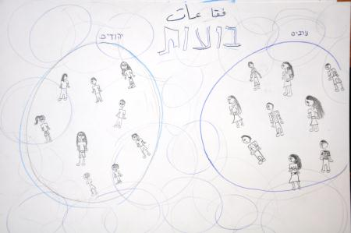
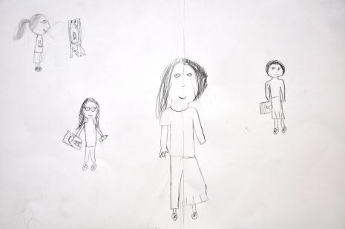
“We’ve learned that there is no 'one' truth, it is somewhere in the middle”
‘Jew’
‘Arab’
‘Bubbles’

Slide 19
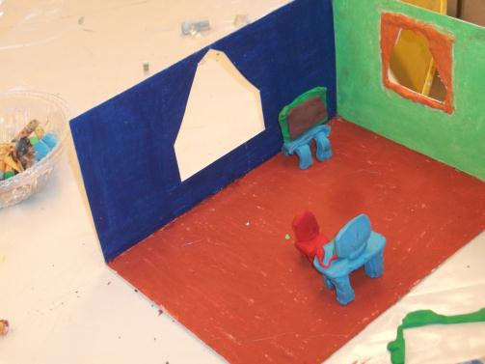
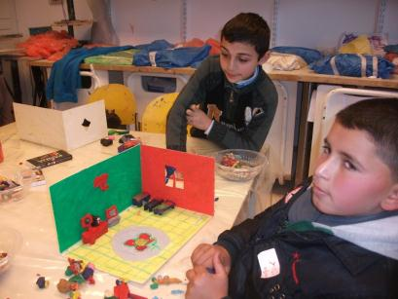
‘Houses’ Project: The participants were divided into mixed pairs and were asked to create a house. What would be in it? What would it look like?

Slide 20
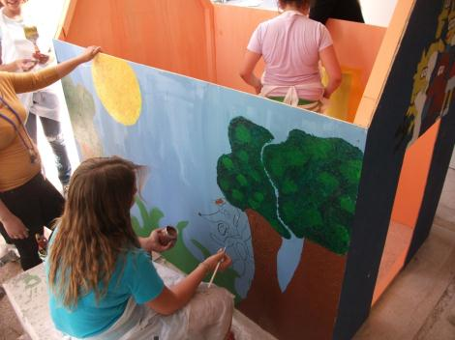
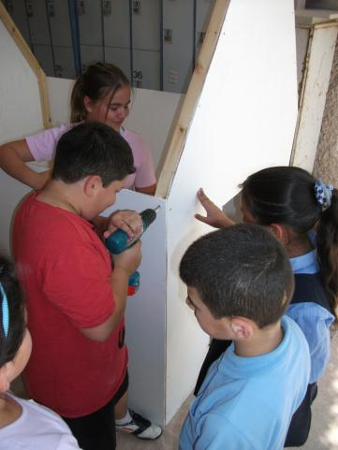
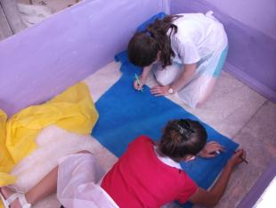
They worked together in harmony, helping each other

Slide 21
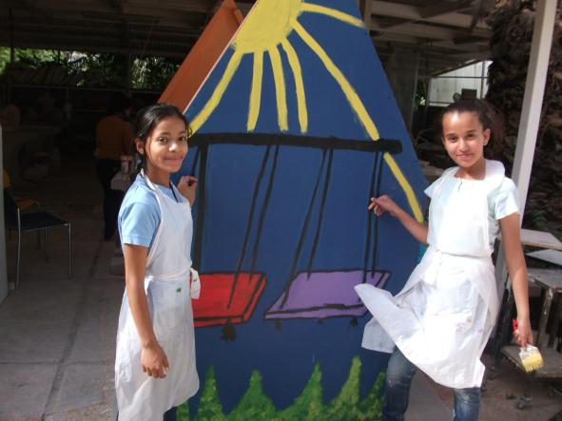
"Perhaps they do not come out of this program 'buddies', but they do leave with a better understanding of what the other side feels, and that's plenty.“ (Eldad Sha’altiel)

Slide 22
“Peace everywhere”
Thank You and Goodbye

